Slide 1
Set Questions
On a piece of paper answer the following:
Why did England want to create colonies in North America?
What was the first attempted colony by English?
What was England's first permanent colony?
Why did the Pilgrims come to the New World?
What was the Mayflower Compact?
Why did the Pilgrims initiate the Thanksgiving Celebration?

Slide 2
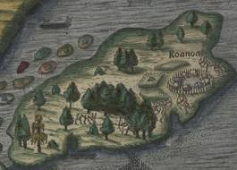
Lost Colony Of Roanoke
Writing Prompt

Slide 3
Learning Targets
I can describe how the English started colonies in North America.
I can describe the challenges early English settlers faced.

Slide 4
Things to Remember….
For ALL type 1 and type 2 writings:
Write down the title (Type 1 or Type 2) and the prompt itself
Follow ALL directions
Type 1
Copy down the writing prompt.
Sentence 1
Sentence 2

Slide 5
Type 1 Writing
Why would someone move thousands of miles from their original home?
Must be two complete sentences
Leave a space between each sentence
Must use proper capitalization (proper nouns, start of sentences, first word of quotes)

Slide 6
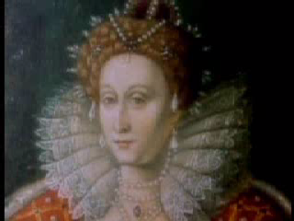
Roanoke Video

Slide 7
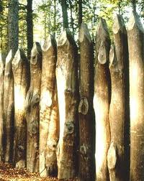
What Could Have Happened?
Clues:
CROATOAN carved on palisade wall
Existence of the Palisade Wall
No Cross carved anywhere
No bodies or skeletons found
No houses found

Slide 8

Theories:
Massacred by local Native Americans
Massacred by the Spanish
Assimilated into a Native American Tribe
Wiped out by Disease
Wiped out by Starvation
Moved somewhere else with better conditions (farmland)
Other

Slide 9
Type 2 - College
Write a letter to John White that explains what you think happened to the Roanoke colonists.
Underline two reasons for your theory.
At least 5 sentences long.
Must use proper capitalization (proper nouns, start of sentences, first word of quotations)

Slide 10
Type 2 - honors
Write a letter to John White that explains what you think happened to the Roanoke colonists.
Underline three reasons for your theory.
At least 8 sentences long.
Must use proper capitalization (proper nouns, start of sentences, first word of quotations)

Slide 11
Remember to….
Pick 1 possible theory
Support your theory with 3 facts/reasons
Underline your 3 supporting facts/reasons
Utilize proper capitalization (proper nouns, start of sentences, first word of quotations)
Put the response in letter form addressed to John White

Slide 12
Closing Discussion
What do you think happened?
How did you support the theory you chose?
Did anyone come up with a credible, alternate theory?

